Slide 1
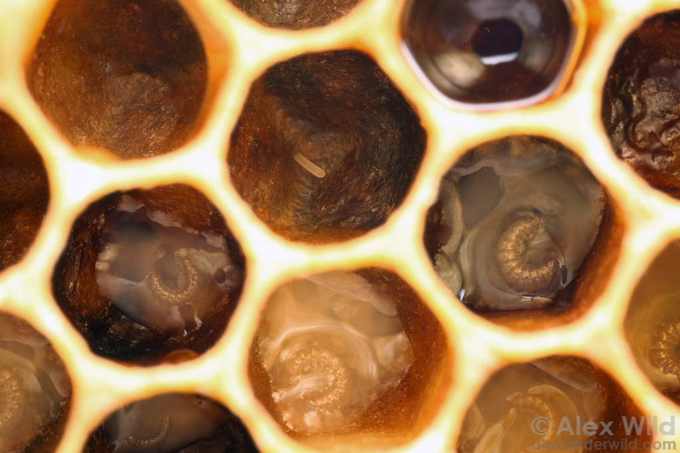
Effects of larval nutritional stress on honey bee disease susceptibility
Adam G. Dolezal,
Alexander R. Walton, & Amy L. Toth
Iowa State University

Slide 2
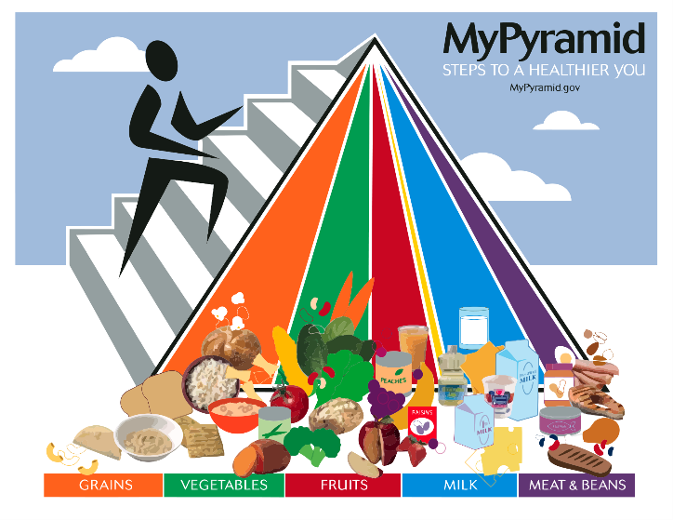
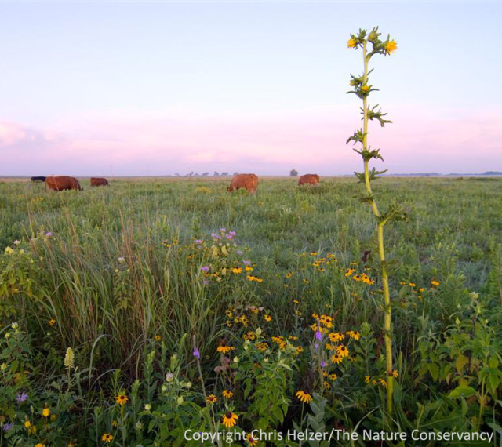
Honey bee adult nutrition
Affects all aspects of honey bee biology
Adult pollen diet affects response to pathogens and immunity

Slide 3
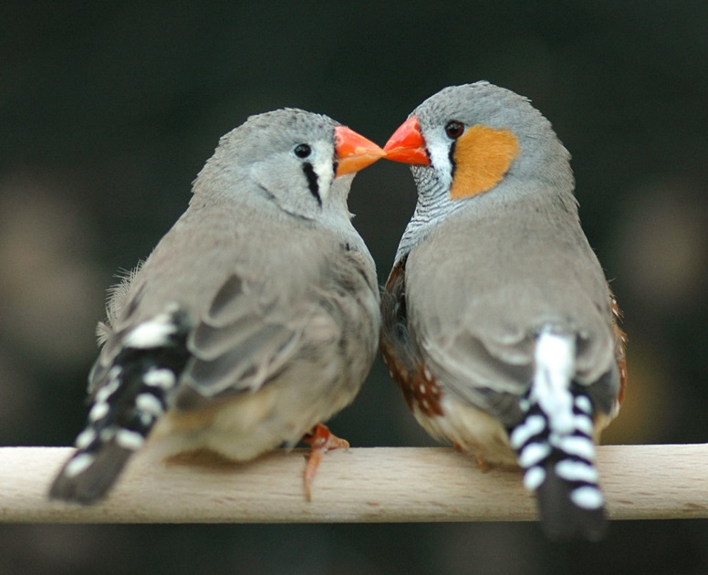
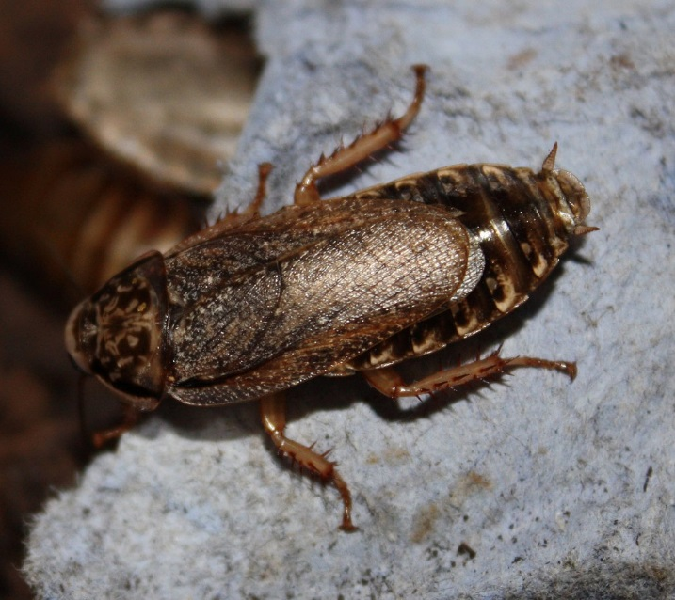
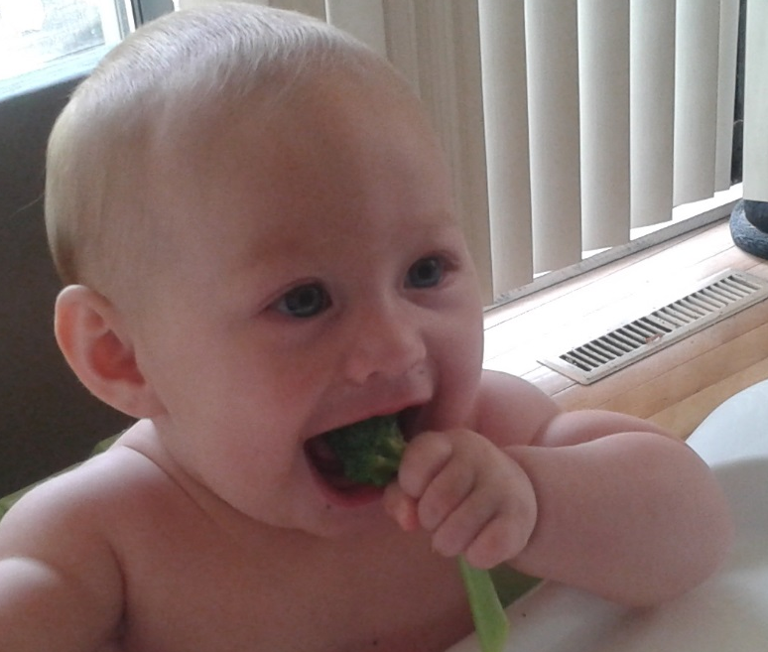
Juvenile nutrition affects adult phenotype
Immune response
Stress resistance
Reproductive potential
Kriengwatana et al 2013
Barrett et al 2009
Lummaa et al 2002

Slide 4


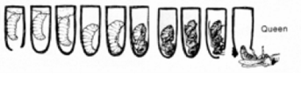
Juvenile nutrition affects adult phenotype
Low quality diet
Worker
High quality diet
Queen
Notes:
----- Meeting Notes (9/9/16 17:08) -----
exclude
on a single slide ...> nutriiton is important to bee behavior,
queen v worker
young v old bees
what about same aged bee varition in behavior?
cite personality behavior

Slide 5
How does worker larval nutrition affect adult health phenotype?
Notes:
----- Meeting Notes (9/9/16 17:08) -----
exclude
on a single slide ...> nutriiton is important to bee behavior,
queen v worker
young v old bees
what about same aged bee varition in behavior?
cite personality behavior

Slide 6
Hypothesis: sublethal perturbation of larval nutrition will increase adult pathogen susceptibility
More susceptible adult
Larval nutritional stress
Notes:
----- Meeting Notes (9/9/16 17:08) -----
exclude
on a single slide ...> nutriiton is important to bee behavior,
queen v worker
young v old bees
what about same aged bee varition in behavior?
cite personality behavior

Slide 7
Prediction 1: a short period of larval starvation will produce more pathogen-susceptible adults
Acute starvation (12 hours)
Notes:
----- Meeting Notes (9/9/16 17:08) -----
exclude
on a single slide ...> nutriiton is important to bee behavior,
queen v worker
young v old bees
what about same aged bee varition in behavior?
cite personality behavior

Slide 8
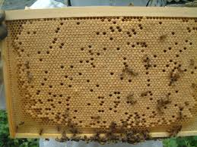
Larval starvation
4 queens caged over open comb
Eggs hatch and develop in hive normally
Push in cage placed over ½ larvae at beginning of L5 stage preventing nurse bee access for 12 hours (Wang et al 2014)
Allows production of same aged sisters with variable starvation
Normal Diet
Starved

Slide 9
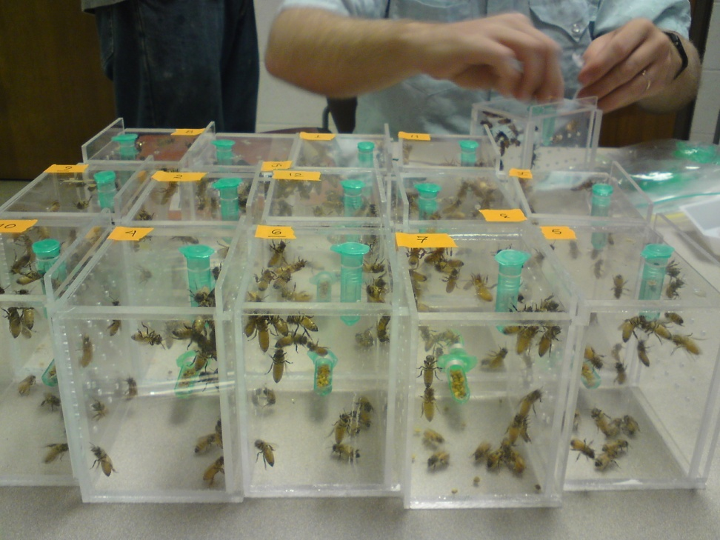
Pathogen model: experimental virus infection with Israeli acute paralysis virus (IAPV)
Notes:
----- Meeting Notes (9/9/16 17:08) -----
exclude
on a single slide ...> nutriiton is important to bee behavior,
queen v worker
young v old bees
what about same aged bee varition in behavior?
cite personality behavior

Slide 10
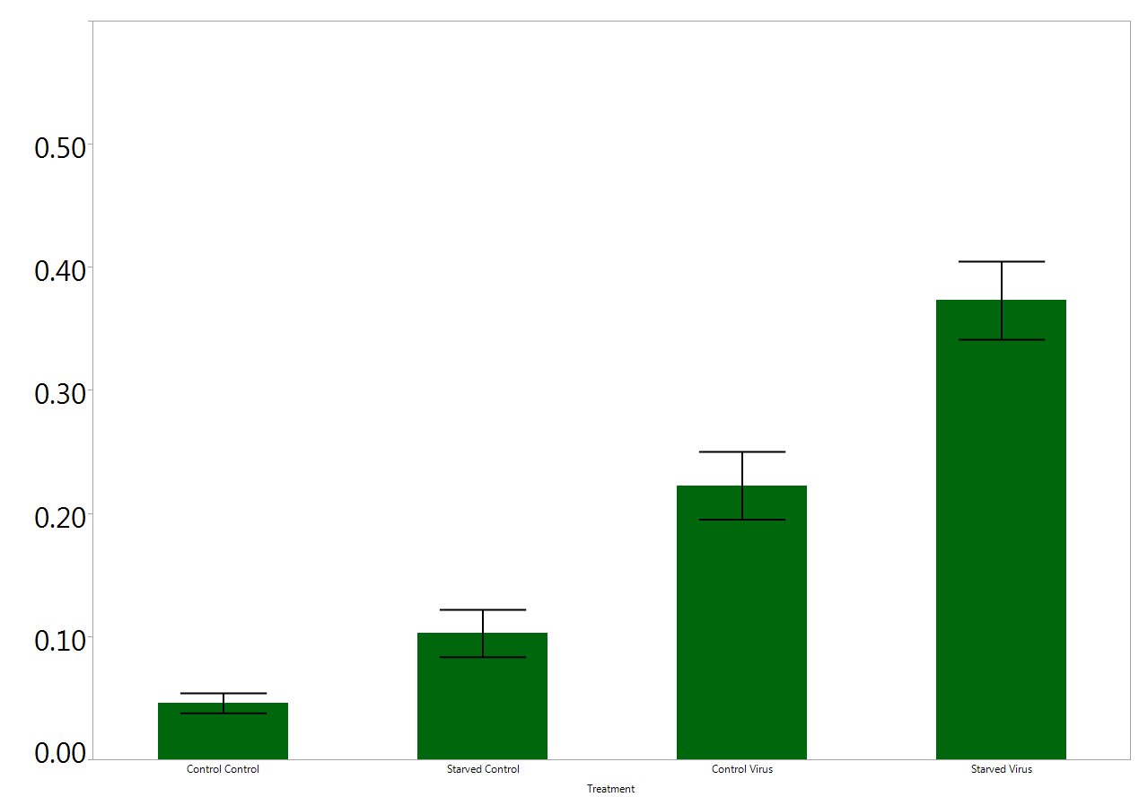
Larval starvation increases virus-induced mortality
C
B
Proportion mortality, 72 h
A
A
Normal Diet
Starved
Normal Diet
Starved
No virus
IAPV challenged
Tukey HSD
N=20

Slide 11
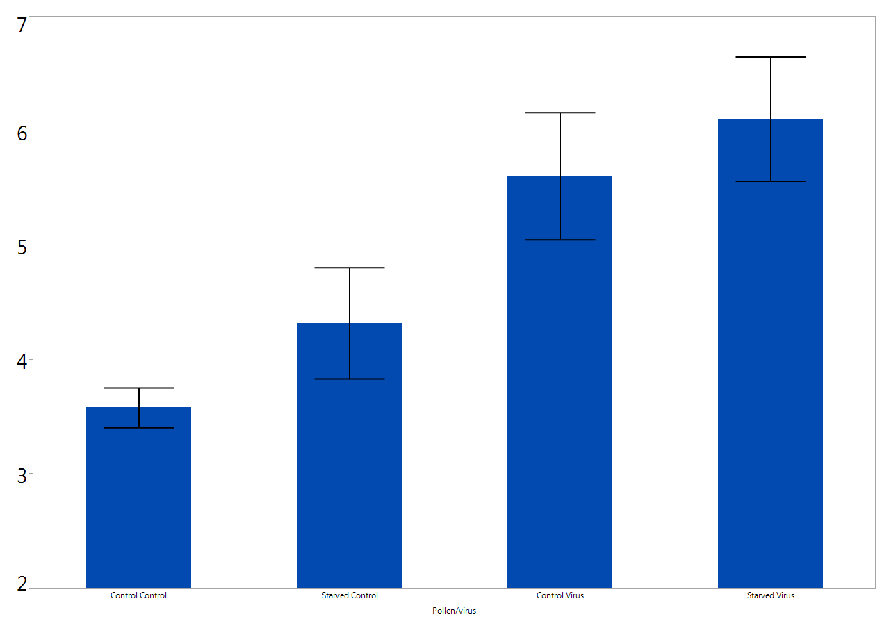
Virus titers are not elevated after larval starvation
C
B, C
A, B
IAPV Log genome equivalents
A
Normal Diet
Starved
Normal Diet
Starved
No virus
IAPV challenged
Tukey HSD
N=20

Slide 12
What is different about these bees?

Slide 13
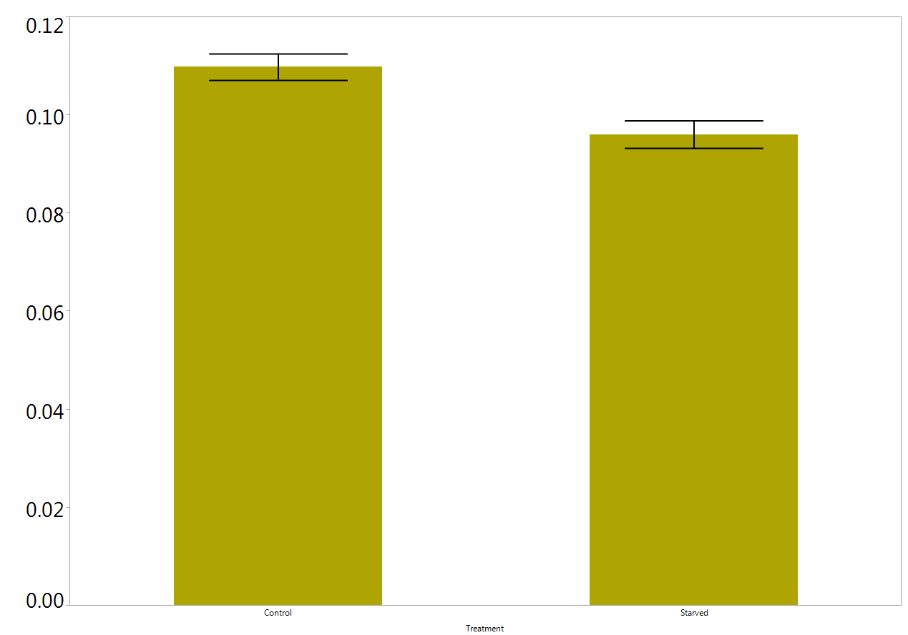
Larval starvation reduces adult emergence mass
*
Mass (g)
Normal Diet
Starved
t-test, <0.05
N=16, 20

Slide 14
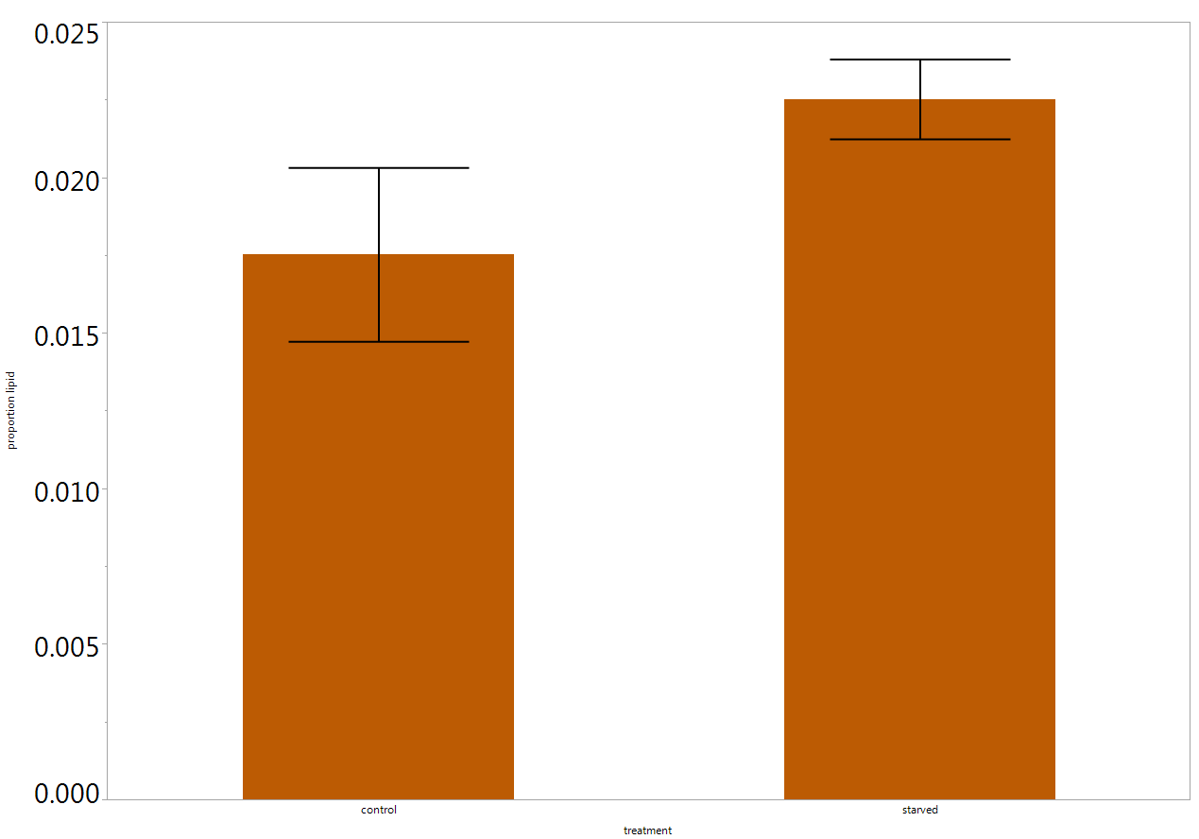
Adult fat stores unaffected by larval starvation
Lipid stores (mg/g)
Normal Diet
Starved
t-test, <0.05
N=10, 12

Slide 15
Conclusion : Acute starvation during larval development increased virus susceptibility
Normal Diet
Starved

Slide 16
Prediction 2: Hive-level pollen nutritional quality will affect adult phenotypes
A more field relevant concern may be larvae raised on a steady diet of low quality pollen
Notes:
----- Meeting Notes (9/9/16 17:08) -----
exclude
on a single slide ...> nutriiton is important to bee behavior,
queen v worker
young v old bees
what about same aged bee varition in behavior?
cite personality behavior

Slide 17
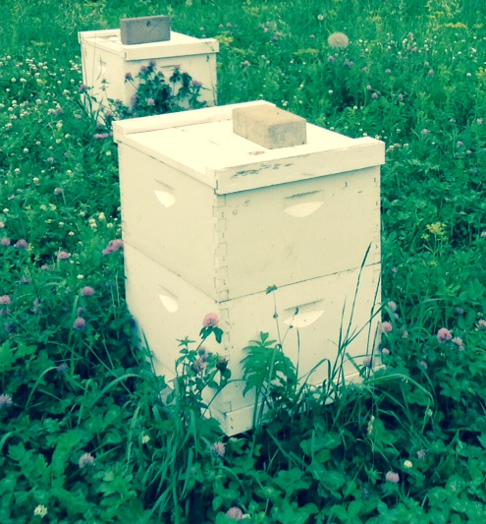
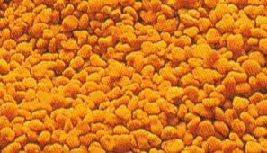
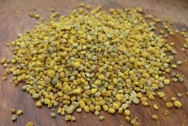
Not all pollen has the same quality
“Bad” Pollen
(Rock Rose (Cistus))
“Good” Pollen
(Chestnut(Castanea))
Dipasquale et al 2013

Slide 18
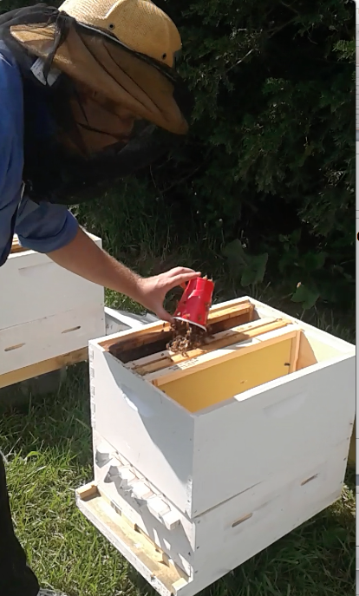
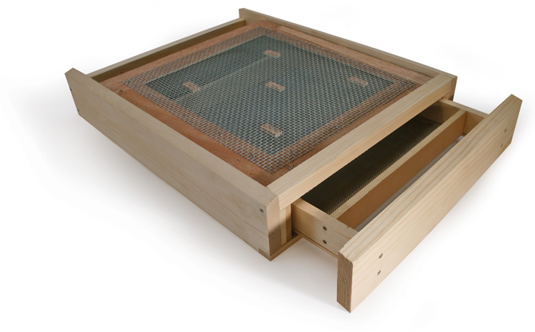

Slide 19
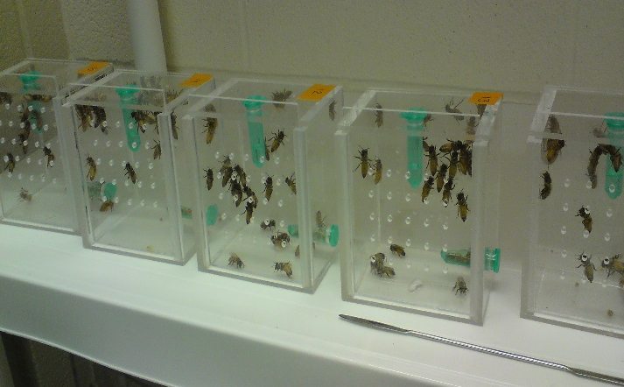

Bad Pollen
(Rock Rose)
Good Pollen
(Chestnut)
Virus challenge

Slide 20
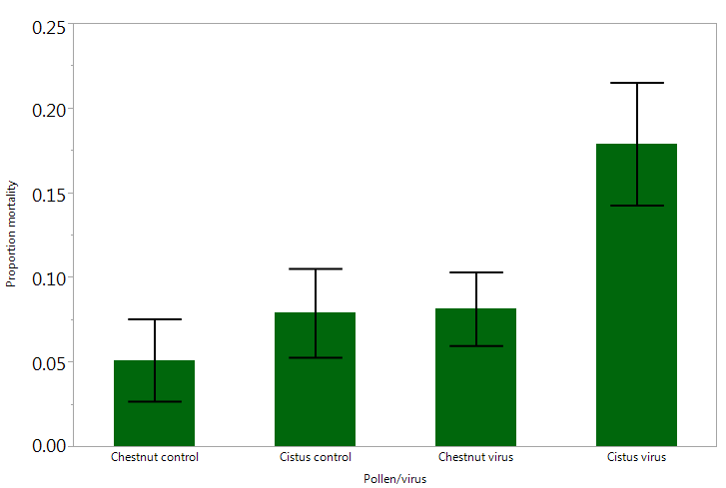
Larvae raised in colonies with low-quality pollen are more susceptible to viruses as adults
B
A
A
A
Proportion mortality, 72 h
Chestnut
Rockrose
Chestnut
Rockrose
No virus
Virus challenged
Steel Dwass, all pairs
N=11, 21, 11, 20

Slide 21
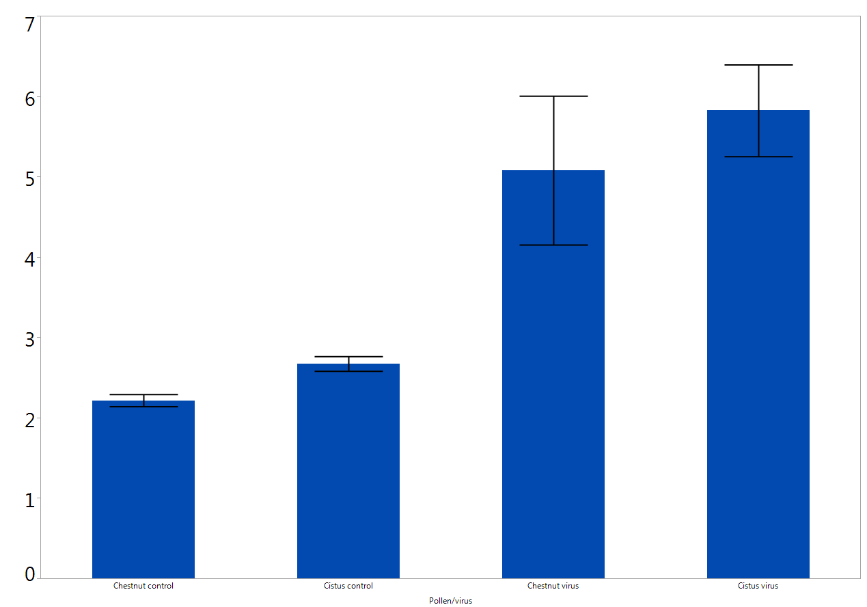
Virus titers are not elevated due to lower quality pollen
B
B
IAPV Log genome equivalents
A
A
Chestnut
Rockrose
Chestnut
Rockrose
No virus
Virus challenged
Tukey HSD
N=11, 21, 11, 20

Slide 22
What’s different about these bees?

Slide 23
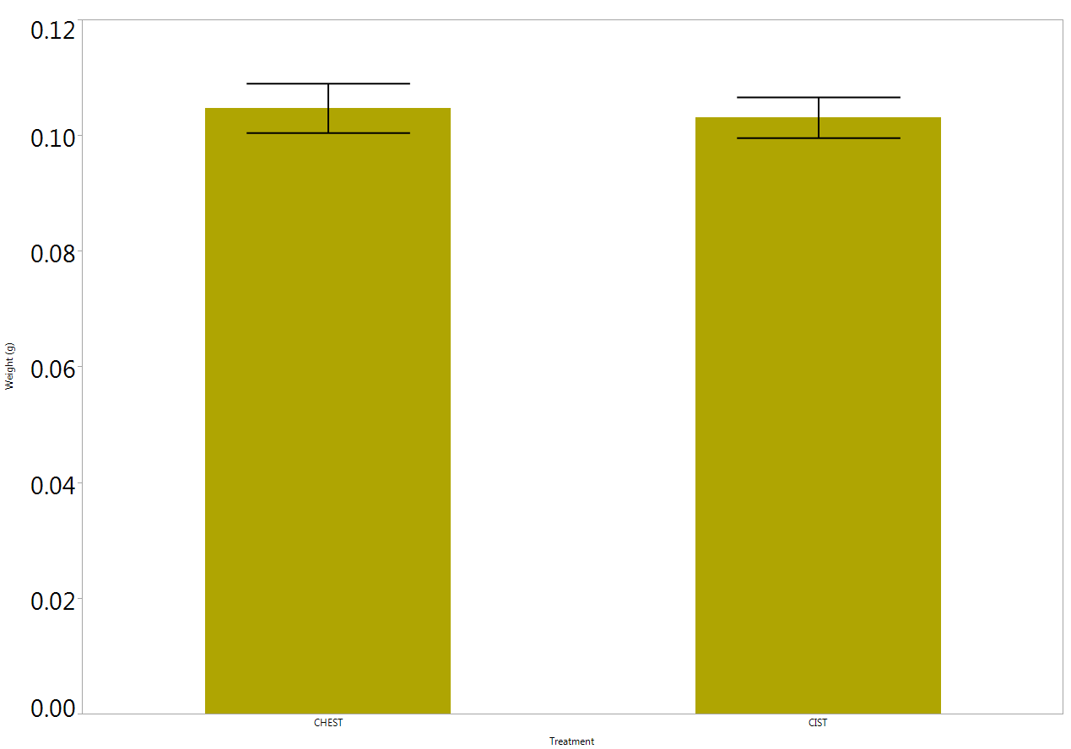
Reduced pollen quality does not affect emergence mass
Mass (g)
Chestnut
Rockrose
t-test, <0.05
N=10, 12

Slide 24
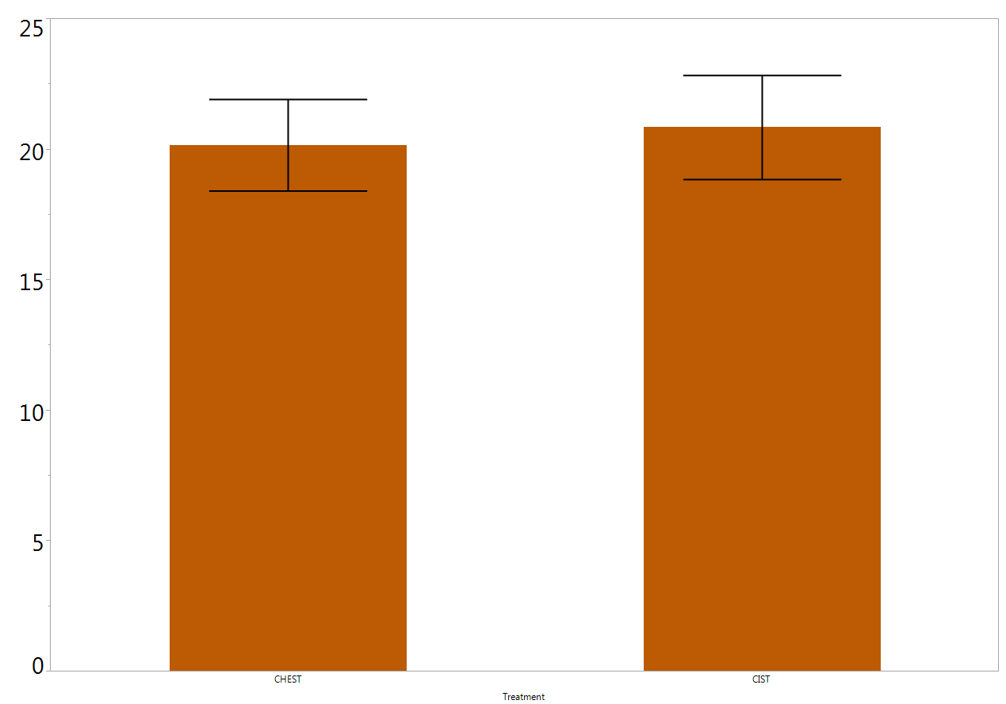
Reduced pollen quality does not affect adult fat stores
Lipid stores (mg/g)
Chestnut
Rockrose
t-test, <0.05
N=10, 12

Slide 25
Acute conclucsions
Larval nutritional stress results in adult bees that are more susceptible to virus challenge
Stressed bees are more likely to die of virus infection
Virus titers are not higher
Virus tolerance vs reduction in replication

Slide 26
Acute conclucsions
What’s different about these diets?
Body size affected by starvation, but not pollen dietary stress
Emergence fat stores not affected in either case
Future testing
Protein
Micronutrients
Immune gene expression

Slide 27
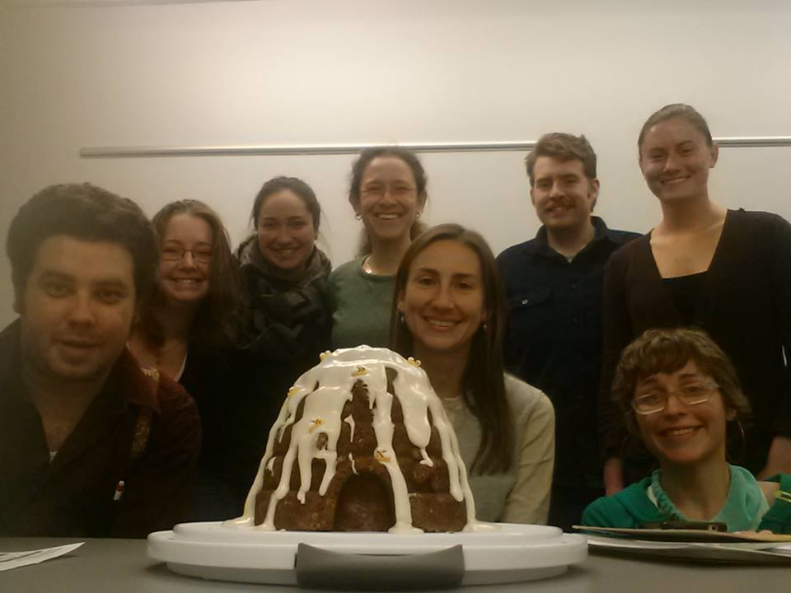
Acute conclucsions
Acknowledgments
Funding
Toth Lab
Jimena Carrillo-Tripp
Bryony Bonning

